Slide 1
The Foundations: Logic and Proofs
Chapter 1, Part I: Propositional Logic
Copyright © McGraw-Hill Education. All rights reserved. No reproduction or distribution without the prior written consent of McGraw-Hill Education.

Slide 2
Chapter Summary
Propositional Logic
  The Language of Propositions
  Applications
  Logical Equivalences
Predicate Logic
  The Language of Quantifiers
  Logical Equivalences
  Nested Quantifiers
Proofs
  Rules of Inference
  Proof Methods
  Proof Strategy

Slide 3
Propositional Logic Summary
The Language of Propositions
  Connectives
  Truth Values
  Truth Tables
Applications
  Translating English Sentences
  System Specifications
  Logic Puzzles
  Logic Circuits
Logical Equivalences
  Important Equivalences
  Showing Equivalence
  Satisfiability

Slide 4
Lecture 1:
Propositional Logic
Section 1.1

Slide 5
Propositions
A proposition is a declarative sentence that is either true or false.
Examples of propositions:
  The Moon is made of green cheese.
  Trenton is the capital of New Jersey.
  Toronto is the capital of Canada.
  1 + 0 = 1
  0 + 0 = 2
Examples that are not propositions.
  Sit down!
  What time is it?
  x + 1 = 2
  x + y = z

Slide 6
Propositional Logic
Propositions that cannot be expressed in terms of simpler propositions are called atomic propositions.
Constructing Propositions
  Propositional Variables: p, q, r, s, …
  The proposition that is always true is denoted by T and the proposition that is always false is denoted by F.

Slide 7
Propositional Logic
Constructing Propositions
  Propositional Variables: p, q, r, s, …
  The proposition that is always true is denoted by T and the proposition that is always false is denoted by F.
  Compound Propositions: constructed from logical connectives and other propositions
    Negation ¬
    Conjunction ∧
    Disjunction ∨
    Implication →
    Biconditional ↔

Slide 8
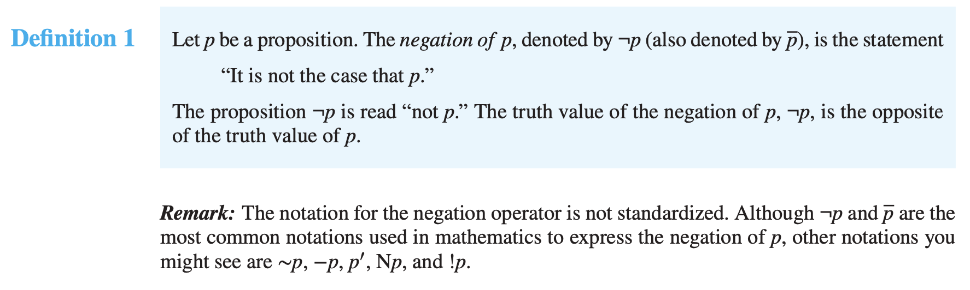
Compound Propositions: Negation

Slide 9
Compound Propositions: Negation
  The negation of a proposition p is denoted by ¬p and has this truth table:
Example: If p denotes “The earth is round.”, then ¬p denotes “It is not the case that the earth is round,” or more simply “The earth is not round.”
p | ¬p
T | F
F | T

Slide 10
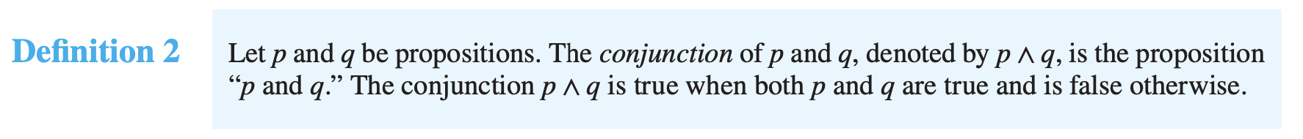
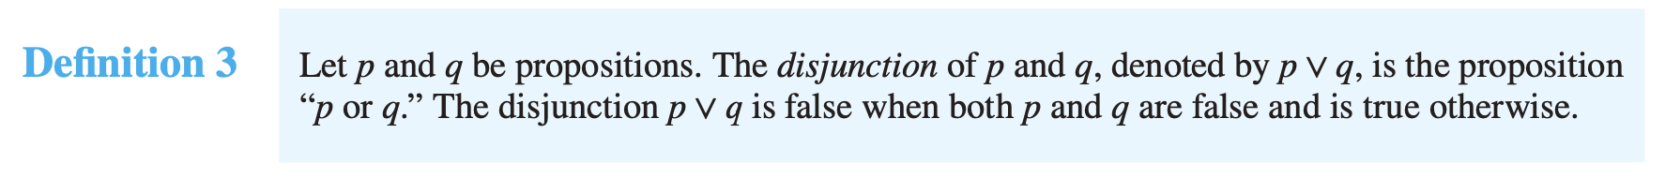
Conjunction & Disjunction

Slide 11
Conjunction
The conjunction of propositions p and q is denoted by p ∧ q and has this truth table:
Example: If p denotes “I am at home.” and q denotes “It is raining.” then p ∧ q denotes “I am at home and it is raining.”
p | q | p ∧ q
T | T | T
T | F | F
F | T | F
F | F | F

Slide 12
Disjunction
The disjunction of propositions p and q is denoted by p ∨q and has this truth table:
Example: If p denotes “I am at home.” and q denotes “It is raining.” then p ∨q denotes “I am at home or it is raining.”
p | q | p ∨q
T | T | T
T | F | T
F | T | T
F | F | F

Slide 13
The Connective Or in English
In English “or” has two distinct meanings.
  “Inclusive Or” - In the sentence “Students who have taken CSE230 or Math120 may take this class,” we assume that students need to have taken one of the prerequisites, but may have taken both. This is the meaning of disjunction. For p ∨q to be true, either one or both of p and q must be true.
  “Exclusive Or” - When reading the sentence “Soup or salad comes with this entrée,” we do not expect to be able to get both soup and salad. This is the meaning of Exclusive Or (Xor). In p ⊕ q , one of p and q must be true, but not both. The truth table for ⊕ is:
p | q | p ⊕q
T | T | F
T | F | T
F | T | T
F | F | F

